Slide 1
Chapter 6: Internet Protocol Version 6 (IPv6)
IT 6003 – Network and Data Communications

Slide 2
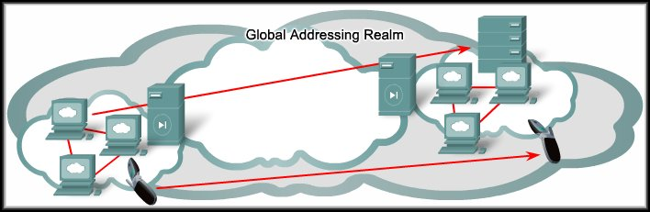

IP Addressing Services
Internet Protocol Version 6
IPv6

Slide 3
IPv6 – Why We Need More Address Space
The IPv4 address space provides approximately 4,294,967,296 unique addresses.
Only 3.7 billion addresses are assignable.
Separates the addresses into classes.
Reserves addresses for multicasting, testing, and other specific uses.
As of January, 2007, approximately 2.4 billion of the available IPv4 addresses are already assigned to end users or ISPs.
Despite the large number, IPv4 address space is running out.
As of September 2012 some parts of the world have ran out of IPv4 addresses.

Slide 4
IPv6 – Why We Need More Address Space
IPv4 Address Allocation
0 | 1 | 2 | 3 | 4 | 5 | 6 | 7 | 8 | 9 | 10 | 11 | 12 | 13 | 14 | 15
16 | 17 | 18 | 19 | 20 | 21 | 22 | 23 | 24 | 25 | 26 | 27 | 28 | 29 | 30 | 31
32 | 33 | 34 | 35 | 36 | 37 | 38 | 39 | 40 | 41 | 42 | 43 | 44 | 45 | 46 | 47
48 | 49 | 50 | 51 | 52 | 53 | 54 | 55 | 56 | 57 | 58 | 59 | 60 | 61 | 62 | 63
64 | 65 | 66 | 67 | 68 | 69 | 70 | 71 | 72 | 73 | 74 | 75 | 76 | 77 | 78 | 79
80 | 81 | 82 | 83 | 84 | 85 | 86 | 87 | 88 | 89 | 90 | 91 | 92 | 93 | 94 | 95
96 | 97 | 98 | 99 | 100 | 101 | 102 | 103 | 104 | 105 | 106 | 107 | 108 | 109 | 110 | 111
112 | 113 | 114 | 115 | 116 | 117 | 118 | 119 | 120 | 121 | 122 | 123 | 124 | 125 | 126 | 127
128 | 129 | 130 | 131 | 132 | 133 | 134 | 135 | 136 | 137 | 138 | 139 | 140 | 141 | 142 | 143
144 | 145 | 146 | 147 | 148 | 149 | 150 | 151 | 152 | 153 | 154 | 155 | 156 | 157 | 158 | 159
160 | 161 | 162 | 163 | 164 | 165 | 166 | 167 | 168 | 169 | 170 | 171 | 172 | 173 | 174 | 175
176 | 177 | 178 | 179 | 180 | 181 | 182 | 183 | 184 | 185 | 186 | 187 | 188 | 189 | 190 | 191
192 | 193 | 194 | 195 | 196 | 197 | 198 | 199 | 200 | 201 | 202 | 203 | 204 | 205 | 206 | 207
208 | 209 | 210 | 211 | 212 | 213 | 214 | 215 | 216 | 217 | 218 | 219 | 220 | 221 | 222 | 223
224 | 225 | 226 | 227 | 228 | 229 | 230 | 231 | 232 | 233 | 234 | 235 | 236 | 237 | 238 | 239
240 | 241 | 242 | 243 | 244 | 245 | 246 | 247 | 248 | 249 | 250 | 251 | 252 | 253 | 254 | 255
1993
Allocated
Unavailable
Available
16,777,216 addresses

Slide 5
IPv6 – Why We Need More Address Space
IPv4 Address Allocation
0 | 1 | 2 | 3 | 4 | 5 | 6 | 7 | 8 | 9 | 10 | 11 | 12 | 13 | 14 | 15
16 | 17 | 18 | 19 | 20 | 21 | 22 | 23 | 24 | 25 | 26 | 27 | 28 | 29 | 30 | 31
32 | 33 | 34 | 35 | 36 | 37 | 38 | 39 | 40 | 41 | 42 | 43 | 44 | 45 | 46 | 47
48 | 49 | 50 | 51 | 52 | 53 | 54 | 55 | 56 | 57 | 58 | 59 | 60 | 61 | 62 | 63
64 | 65 | 66 | 67 | 68 | 69 | 70 | 71 | 72 | 73 | 74 | 75 | 76 | 77 | 78 | 79
80 | 81 | 82 | 83 | 84 | 85 | 86 | 87 | 88 | 89 | 90 | 91 | 92 | 93 | 94 | 95
96 | 97 | 98 | 99 | 100 | 101 | 102 | 103 | 104 | 105 | 106 | 107 | 108 | 109 | 110 | 111
112 | 113 | 114 | 115 | 116 | 117 | 118 | 119 | 120 | 121 | 122 | 123 | 124 | 125 | 126 | 127
128 | 129 | 130 | 131 | 132 | 133 | 134 | 135 | 136 | 137 | 138 | 139 | 140 | 141 | 142 | 143
144 | 145 | 146 | 147 | 148 | 149 | 150 | 151 | 152 | 153 | 154 | 155 | 156 | 157 | 158 | 159
160 | 161 | 162 | 163 | 164 | 165 | 166 | 167 | 168 | 169 | 170 | 171 | 172 | 173 | 174 | 175
176 | 177 | 178 | 179 | 180 | 181 | 182 | 183 | 184 | 185 | 186 | 187 | 188 | 189 | 190 | 191
192 | 193 | 194 | 195 | 196 | 197 | 198 | 199 | 200 | 201 | 202 | 203 | 204 | 205 | 206 | 207
208 | 209 | 210 | 211 | 212 | 213 | 214 | 215 | 216 | 217 | 218 | 219 | 220 | 221 | 222 | 223
224 | 225 | 226 | 227 | 228 | 229 | 230 | 231 | 232 | 233 | 234 | 235 | 236 | 237 | 238 | 239
240 | 241 | 242 | 243 | 244 | 245 | 246 | 247 | 248 | 249 | 250 | 251 | 252 | 253 | 254 | 255
August
2009
Allocated
Unavailable
Available
16,777,216 addresses
http://www.personal.psu.edu/dvm105/blogs/ipv6/

Slide 6
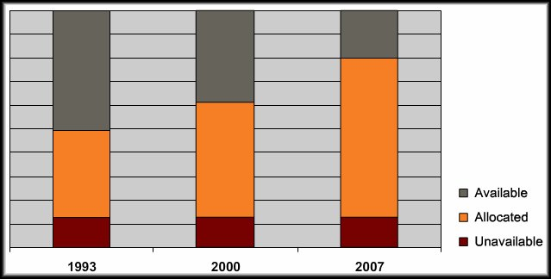
IPv6 – Why Is Address Space Shrinking?
Population Growth:
The Internet population is growing.
November 2005, Cisco estimate: 973 million users.
This number has doubled since then.
Users stay on longer.
Reserve IP addresses for longer periods.
Contacting more and more peers daily.
Mobile Users:
More than one billion mobile phones.
More than 20 million IP-enabled mobile devices.
Transportation:
There will be more than one billion automobiles by 2008.
Newer models are IP-enabled to allow remote monitoring.
Consumer Electronics:
The newest home appliances allow remote monitoring using IP technology.
e.g. Digital Video Recorders (DVRs) that download and update program guides.
Home networking.

Slide 7
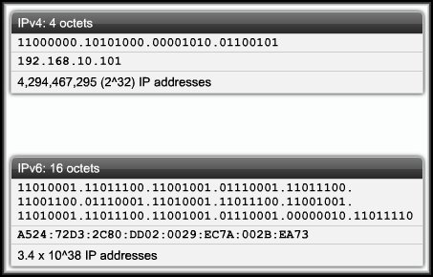
Reasons for Using IPv6
The ability to scale networks for future demands requires a limitless supply of IP addresses and improved mobility.
DHCP and NAT alone cannot meet these requirements.
IPv6 satisfies the increasingly complex requirements of hierarchical addressing that IPv4 does not provide. Address Availability:
---------------------------------------------------------------------
---------------------------------------------------------------------
IPv4: 4 octets - 32 bits
2^32 or 4,294,467,295 IP Addresses.
IPv6: 16 octets - 128 bits
3.4 x 10^38 or 340,282,366,920,938,463,463,374,607,431,768,211,456
(340 undecillion) IP Addresses.
Every atom of every person on Earth could be assigned 7 unique addresses with some to spare (assuming 7 × 10²⁷ atoms per human x 6.5 Billion).

Slide 8
IPv6 Addressing
Characteristic | IPv4 | IPv6
Format | x.x.x.x 4, 8-bit fields Separated by dots | x:x:x:x:x:x:x:x 8, 16-bit fields Separated by colons
Field Representation | Decimal Format | Groups of 4 hexadecimal digits, case sensitive for A, B, C, D, E and F.
Leading Zeroes | Omitted | Optional
Successive Zero Fields | Must be included | Can be represented by “::” once in an address.

Slide 9
IPv6 Addressing
IPv6 Representation – Rule 1:
The leading zeroes in any 16-bit segment do not have to be written. If any 16-bit segment has fewer than four hexadecimal digits, it is assumed that the missing digits are leading zeroes.
2031 | : | 0000 | : | 130F | : | 0000 | : | 0000 | : | 09C0 | : | 876A | : | 130B
2031 | : | 0 | : | 130F | : | 0 | : | 0 | : | 9C0 | : | 876A | : | BC00
8105 | : | 0000 | : | 0000 | : | 4B10 | : | 1000 | : | 0000 | : | 0000 | : | 0005
8105 | : | 0 | : | 0 | : | 4B10 | : | 1000 | : | 0 | : | 0 | : | 5
0000 | : | 0000 | : | 0000 | : | 0000 | : | 0000 | : | 0000 | : | 0000 | : | 0000
0 | : | 0 | : | 0 | : | 0 | : | 0 | : | 0 | : | 0 | : | 0

Slide 10
Activity 1:
Complete problems in page 4 and 5

Slide 11
IPv6 Addressing
IPv6 Representation – Rule 2:
Any single, contiguous string of one or more 16-bit segments consisting of all zeroes can be represented once with a double colon.
1080:0:0:0:8:800:200C:417A | = | 1080::8:800:200C:417A
FF01:0:0:0:0:0:0:101 | = | FF01::101
0:0:0:0:0:0:0:1 | = | ::1
0:0:0:0:0:0:0:0 | = | ::

Slide 12
IPv6 Addressing
IPv6 Representation – Rule 2:
Any single, contiguous string of one or more 16-bit segments consisting of all zeroes can be represented once with a double colon.
Example: 1843:f01::22::fa
Illegal because the length of the two all-zero strings is ambiguous.
1843:00f0:0000:0000:0022:0000:0000:00fa
1843:00f0:0000:0000:0000:0022:0000:00fa
1843:00f0:0000:0022:0000:0000:0000:00fa
or
or

Slide 13
Activity 2:
Complete the problems from page 6 to 10.

Slide 14
IPv6 Addressing
IPv6 Representation:
Prefix:
IPv4 prefix (the network portion of the address) can be dotted decimal or bit count.
e.g. 198.10.0.0 255.255.255.0 or /16
IPv6 prefix is always represented by bit count.
e.g. 3ef8:ca62:12:cc::2/64 16 32 48 64
In a URL, it is enclosed in brackets.
http://[2001:1:4F3A::206:AE14]:8080/index.html
URL parsers have to be modified.
Cumbersome for users.
Mostly for diagnostic purposes.
Use Fully Qualified Domain Names (FQDN).
DNS MUST WORK!

Slide 15
IPv6 Addressing
IPV6 Address Types:
Unicast:
Global Unicast Address.
Link Local Unicast.
Unique Local Unicast.
Multicast.
Anycast.
Unlike IPv4, there is no broadcast address.
There is an “all nodes multicast” which serves the same purpose.

Slide 16
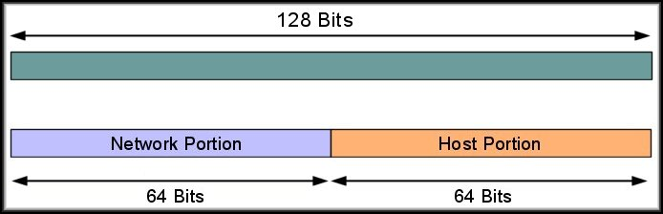
IPv6 Addressing
Unicast Addressing:
A unicast address is an address that identifies a single device.
A global unicast address is a unicast address that is globally unique.
Can be routed globally with no modification.
How do we make a device globally identifiable?

Slide 17

IPv6 Addressing
Global Unicast Address:
How do we make a device globally identifiable?
The host portion of the address is called the Interface ID Can contain:
The interface’s 48-bit MAC Address.
An identifier derived from the EUI-64 Address A manually configured address.
The address more correctly identifies an interface on a host than a host itself.
A single interface can have multiple IPv6 addresses, and can have an IPv4 address in addition.

Slide 18
IPv6 Addressing
Global Unicast Address:
So, how do we make this address globally routable?
We’ll divide the network portion so that there is room for:
The individual site administrator to add subnets.
The remainder of the network portion will identify the remainder of the hierarchy.

Slide 19
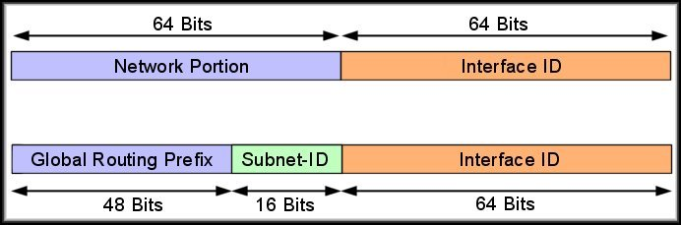
IPv6 Addressing
Global Unicast Address:
So, how do we make this address globally routable?
Using 16 bits for the Subnet-ID allows 65,536 separate subnets…..(that might be enough)…

Slide 20

IPv6 Addressing
Global Unicast Address:
So, how do we make this address globally routable?
Making the Subnet ID a part of the network portion creates a clear separation of functions.
The network portion provides the location of a device down to the specific data link.
The host portion provides the identity of the device on the data link.

Slide 21
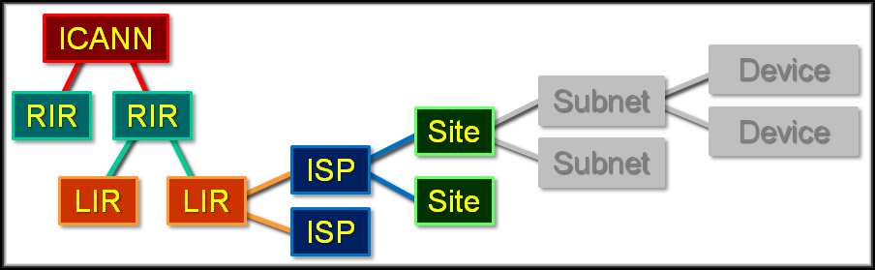
IPv6 Addressing
Global Unicast Address:
So, how do we make this address globally routable?
So, what do we have left?

Slide 22
IPv6 Addressing
IPv6 Global Unicast Address:
To understand the prefix, we need to know the function of each organization in the hierarchy.
ICANN (Internet Corporation for Assigned Names and Numbers):
Manages the DNS Root Zone.
Coordinates the global IP and AS number space and assigns them to the RIRs.

Slide 23
IPv6 Addressing
IPv6 Global Unicast Address:
To understand the prefix, we need to know the function of each organization in the hierarchy.
RIR (Regional Internet Registry):
Oversees allocation and registration of Internet number resources within a particular region of the world.
IP addresses (both IPv4 and IPv6) and autonomous system numbers.

Slide 24
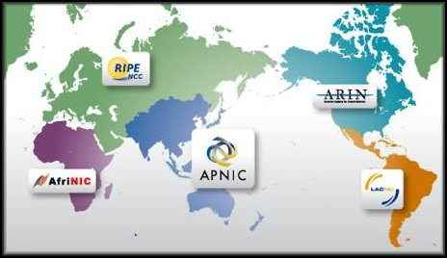
IPv6 Addressing
IPv6 Global Unicast Address:
RIR (Regional Internet Registry):
AfriNIC | Africa region
APNIC | Asia and Pacific region
ARIN | Canada, many Caribbean and North Atlantic islands, and the United States
LACNIC | Latin America and parts of the Caribbean
RIPE NCC | Europe, Parts of Asia and the Middle East

Slide 25
IPv6 Addressing
IPv6 Global Unicast Address:
To understand the prefix, we need to know the function of each organization in the hierarchy.
LIR (Local Internet Registry):
Usually large Internet Service Providers.
Received an IP address allocation from a Regional Internet Registry (RIR).
May assign parts of this allocation to its own customers or smaller ISPs.

Slide 26
IPv6 Addressing
IPv6 Global Unicast Address:
To understand the prefix, we need to know the function of each organization in the hierarchy.
ISP (Internet Service Provider):
A company that offers its customers access to the Internet.
The ISP connects to its customers using an appropriate data transmission technology.

Slide 27
IPv6 Addressing
IPv6 Global Unicast Address:
To understand the prefix, we need to know the function of each organization in the hierarchy.
Site:
The end customer of an ISP.
Can be individuals or corporations requiring Internet access.

Slide 28
IPv6 Addressing
IPv6 Global Unicast Address:
So, how do we make this address globally routable?
With very few exceptions:
Interface ID is 64 bits.
Subnet ID is 16 bits.
The ICANN and the Regional Internet Registries (RIRs) assign IPv6 prefixes (normally /23) to the Local Internet Registries (LIRs).

Slide 29
IPv6 Addressing
IPv6 Global Unicast Address:
So, how do we make this address globally routable?
The LIRs and ISPs then allocate longer prefixes to their customers.
In the majority of cases, the prefixes assigned are /48.

Slide 30

IPv6 Addressing
IPv6 Global Unicast Address:
So, how do we make this address globally routable?
Begins with binary 001.
More easily recognized as beginning with a hexadecimal 2 or 3.
0010 xxxx or 0011 xxxx
ICANN assigns global unicast IPv6 addresses as public and globally-unique IPv6 addresses.
No need for NAT.

Slide 31
IPv6 Addressing
Reserved Addresses:
A portion of the IPv6 address space is reserved for various uses, both present and future.
Address Type | High Order Bits (Binary) | High-Order Bits (Hex)
Unspecified | 00…0 | ::/128
Loopback | 00…1 | ::1/128
Multicast | 11111111… | FF00::/8
Link Local Unicast | 1111111010 | FE80::/10
Global Unicast | 001 | 2xxx::/4 or 3xxx::/4
Reserved (Future Global unicast) | Everything Else

Slide 32
IPv6 Addressing
Multicast Address(FF00::/8):
Examples of well-known IPv6 Multicast Addresses
Address | Multicast Group
FF02::1 | All Nodes
FF02::2 | All Routers
FF02::5 | OSPFv3 Routers
FF02::6 | OSPFv3 Designated Routers
FF02::9 | RIPng Routers
FF02::A | EIGRP Routers
FF02::B | Mobile Agents
FF02:C | DHCP Servers / Relay Agents
FF02::D | All PIM Routers

Slide 33

Go to Moodle...

